Slide 1
Spotify Database
Adit Fadhillah, Naomi Knudsen & Nikolaj Schaltz

Slide 2
What do we want to do?
Make it possible to look up albums and find the songs
Find the discography of an artist
See who an artist has collaborated with
Look up which artist has made a song
Find length of songs and albums
Find release date of songs
Eventually we could also filter song by explicitly, danceability and tempo

Slide 3
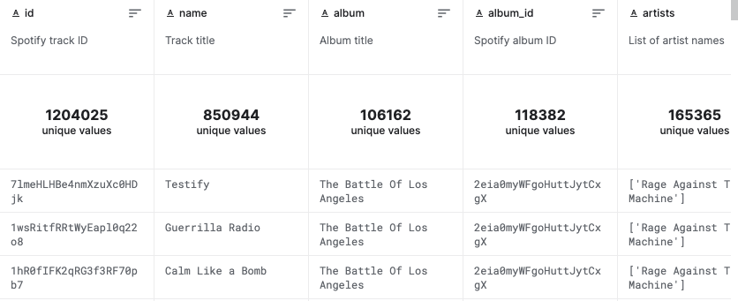
Data from kaggle.com
https://www.kaggle.com/datasets/rodolfofigueroa/spotify-12m-songs

Slide 4
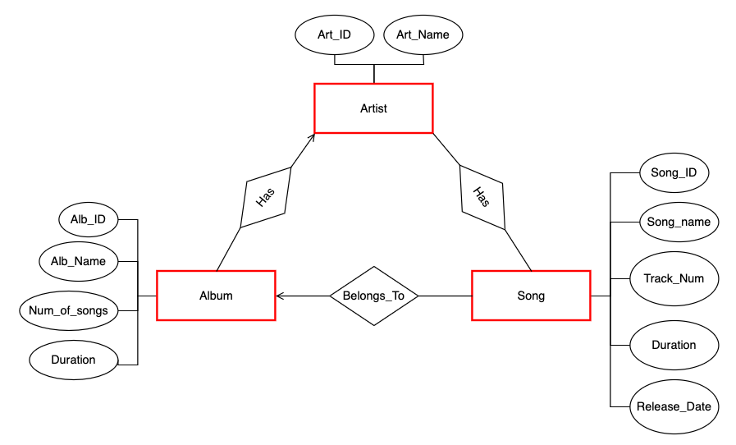
E/R diagram

